Slide 1
CIND 820 Final Project Ryan Boyd
LiDAR Point Cloud Object Extraction

Slide 2
Introduction: Project Goal and Research Question

Slide 3
Tools
Python
Jupyter notebooks
Pandas
Sci-kit learn
Laspy
Matplotlib
Python Image Library (PIL/pillow)
QGIS
Clipping DEM, Imagery
3D Visualization

Slide 4
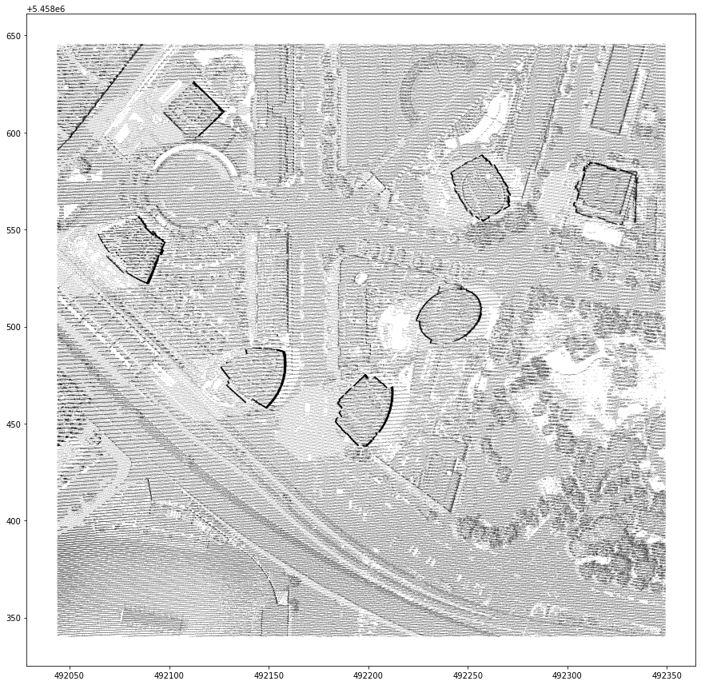
LiDAR LAS Data Point Cloud
798,900 total points
70,247 classified ground
728,653 unclassified
Attributes:
X
Y
Z
Intensity
Classification
Return Number
Return Count

Slide 5
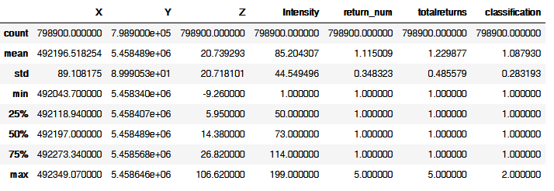
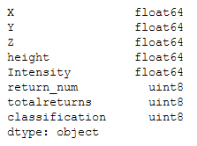
Descriptive Statistics

Slide 6
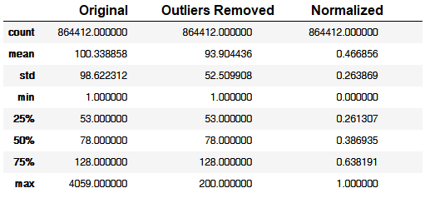
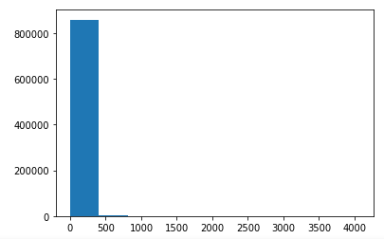
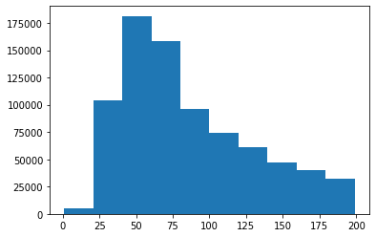
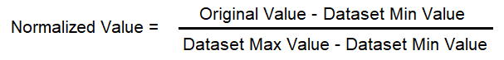

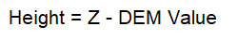
Preprocessing
Outliers removed – Intensity:
Data normalized
Height relative to ground extracted
R,G,B values from imagery extracted

Slide 7
Models/Algorithms
Random Forest Decision Tree
Uses to classify ground
K-means clustering
Used to classify by height and intensity
DBSCAN spatial clustering
Classifies by spatial-horizontal(X,Y) distance

Slide 8
Performance Measures
Calinski-Harabsz Score
aka Variance Ratio Criterion
Ratio of distance of points within clusters to distance of cluster centres
Silhouette Score
Measure of cluster overlap
Between -1 and 1

Slide 9
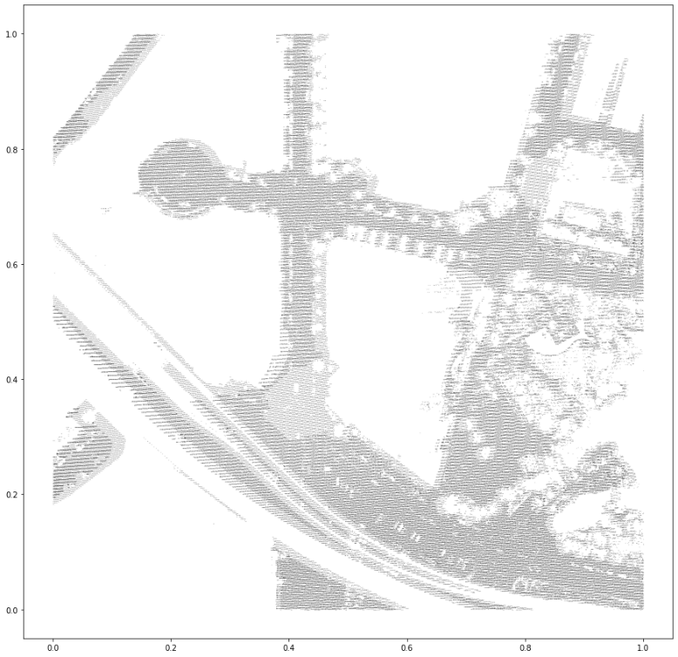
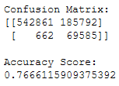
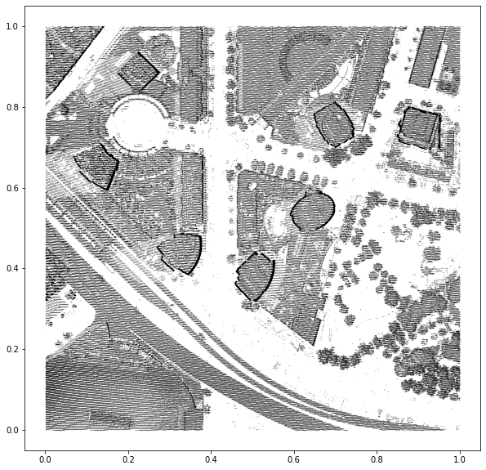
Random Forest: Ground class

Slide 10
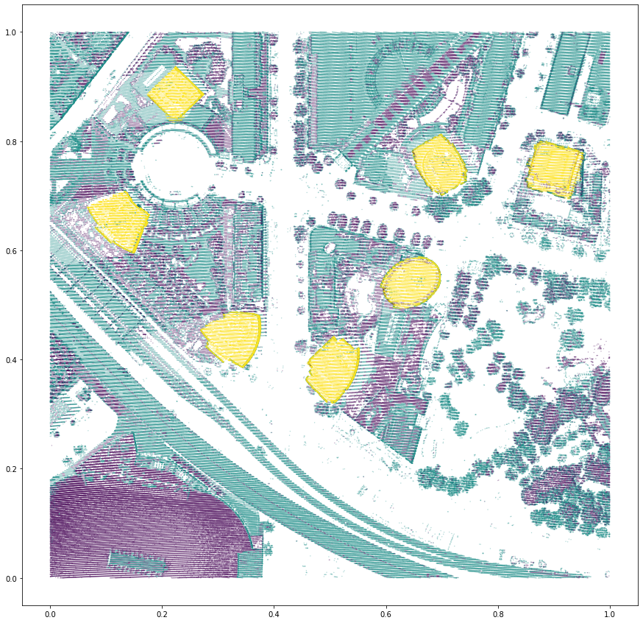
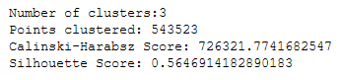
K-Means: Height and Intensity

Slide 11
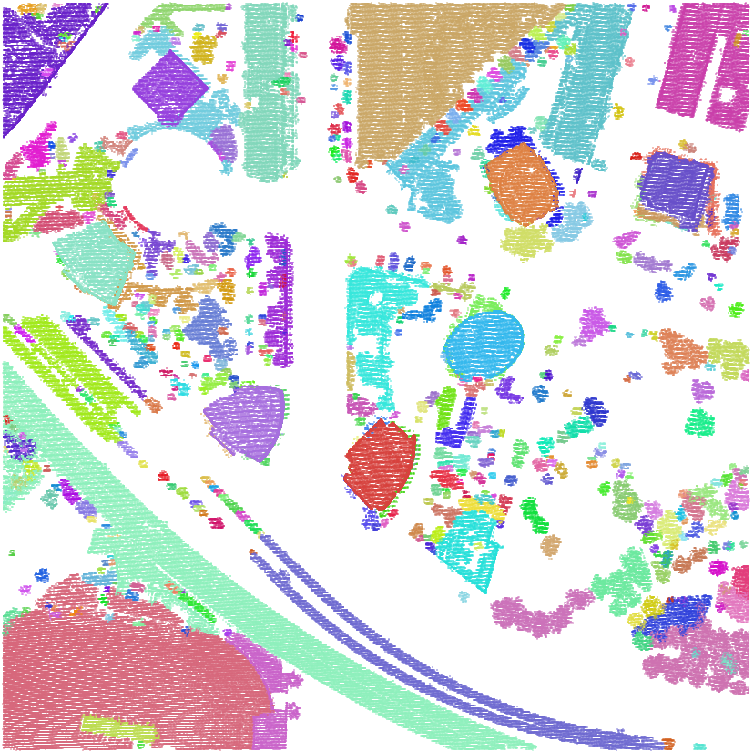
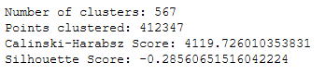
DBSCAN: Spatial Clustering
‘eps’
Minimum distance between points
min_points
Points required to make a cluster

Slide 12
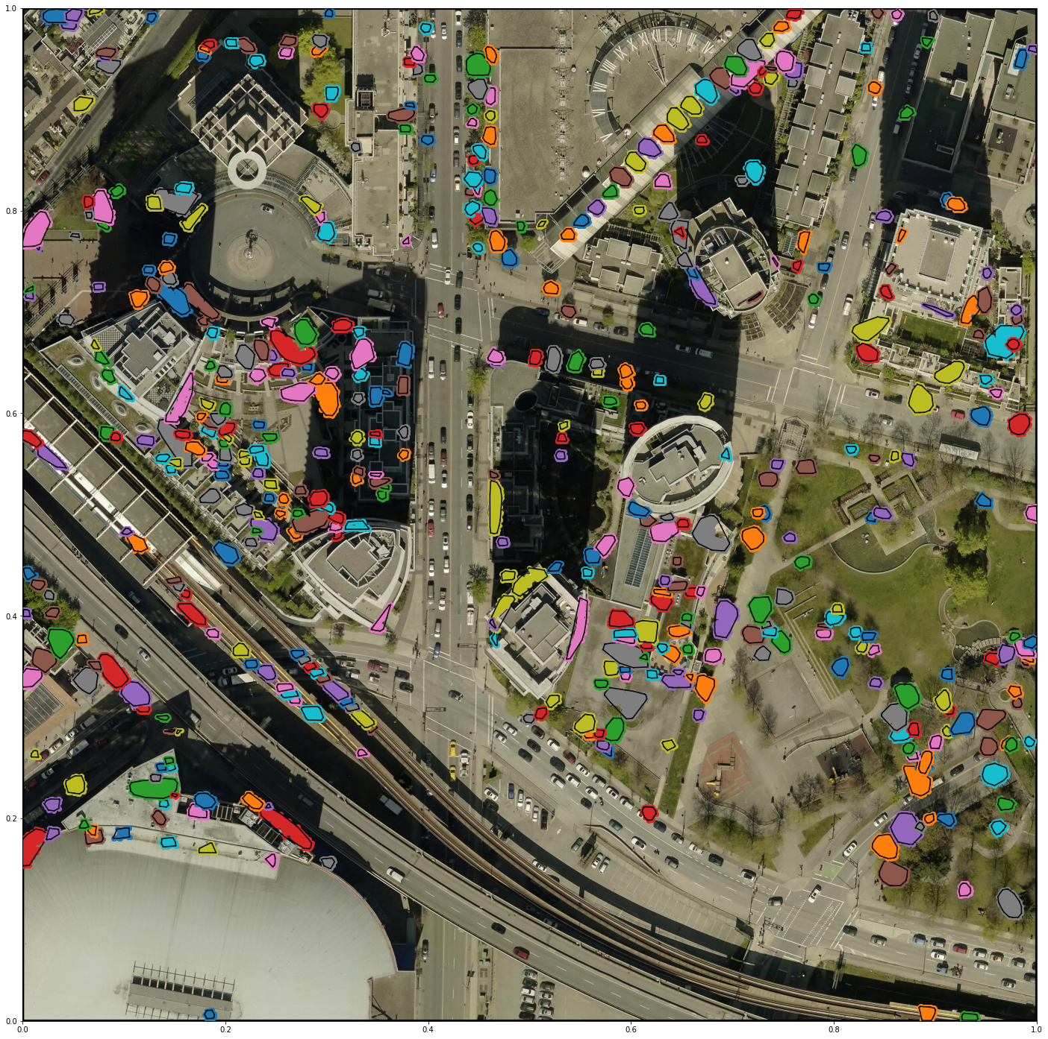
Small Clusters
Less than 500 points
489 features
Trees
Balconies
Window panes
Rooftop features

Slide 13
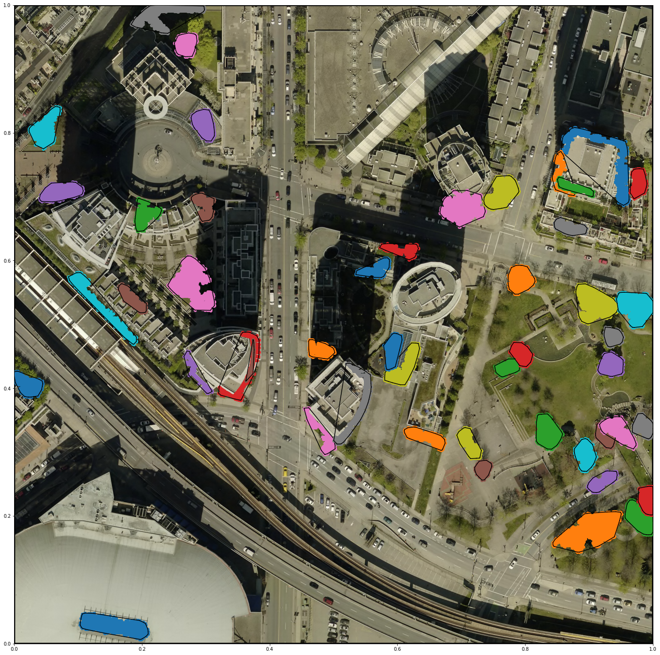
Medium Clusters
Between 500 and 2500 points
48 features
Large tree canopies (likely lower height)
Balconies

Slide 14
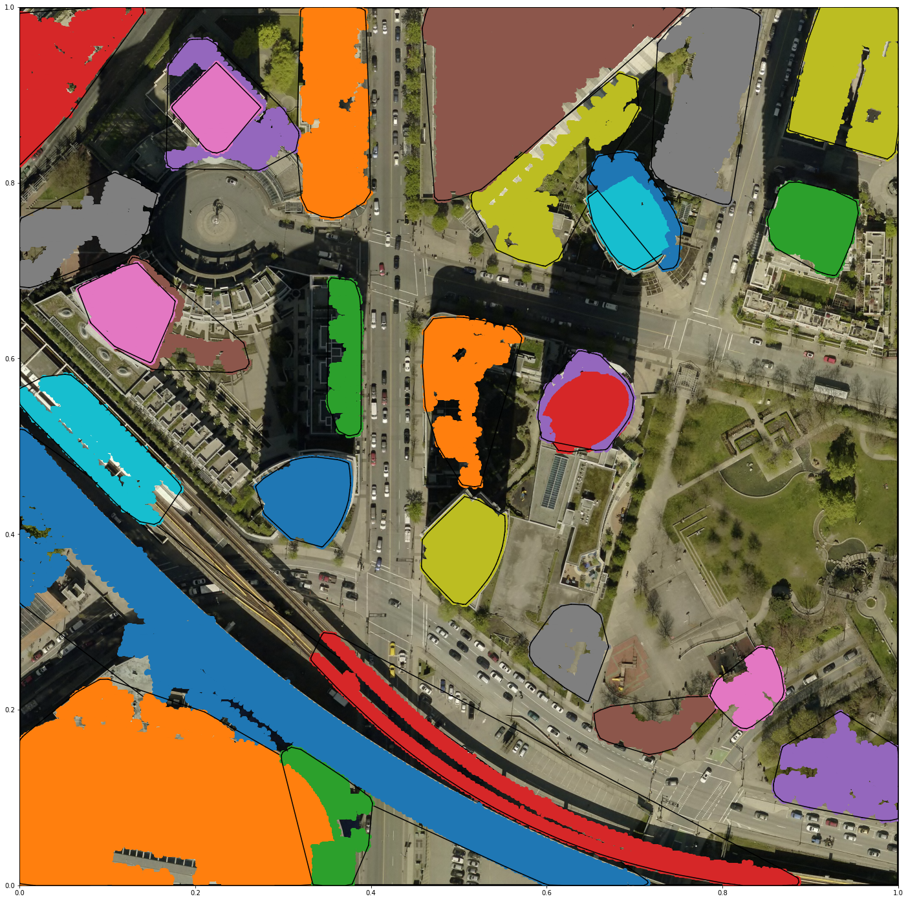
Large Clusters
Over 2500 points
29 features
Building footprints
Large canopies
Large Buildings
Raised roadway
Raised Railway

Slide 15


Slide 16
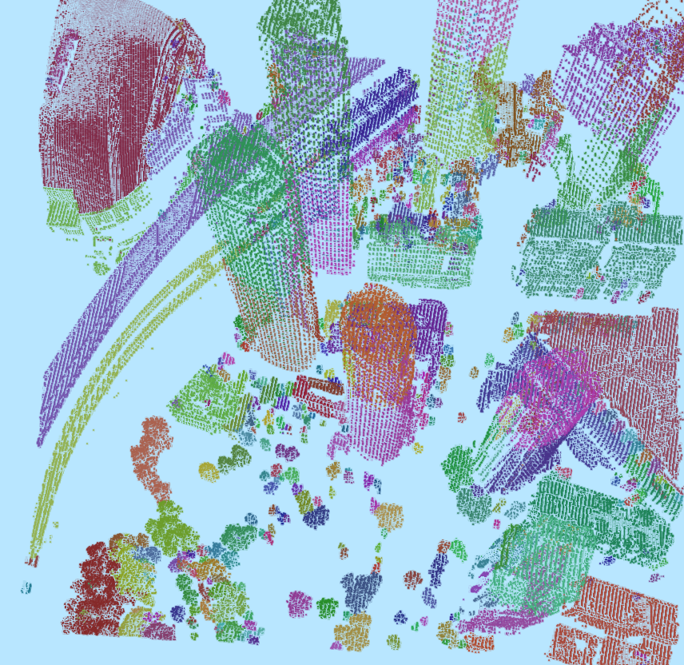

Slide 17
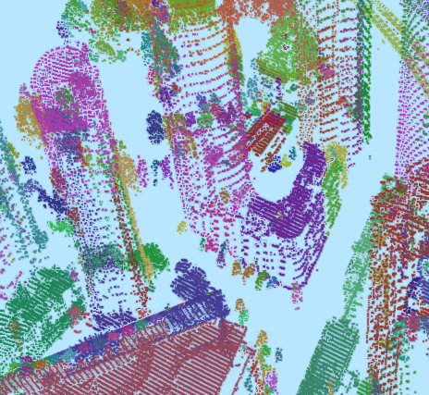

Slide 18
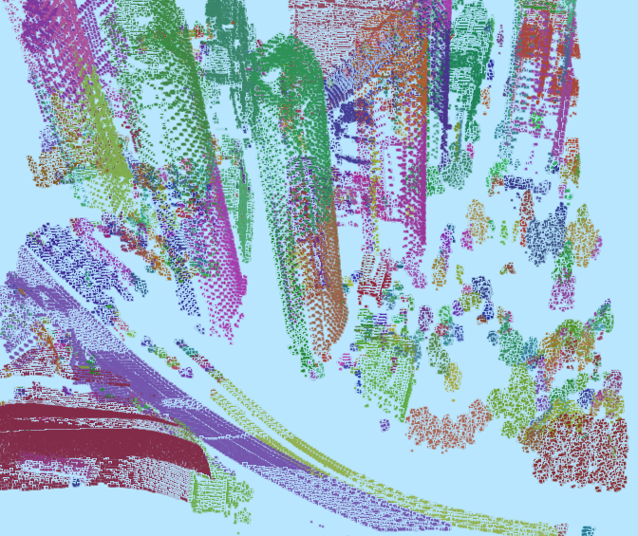

Slide 21
Thank you. Questions

